Slide 1
AI (Artificial Intelligence)
1956 – “Artificial Intelligence” was coined at the Dartmouth Conference This event is considered the birth of AI as a research field.
Artificial Intelligence (AI) - Machines think, learn, and act like humans. It's about creating systems that can perceive, reason, learn, and make decisions.
LLM - Large Language Model
Ai System Types:
Generative AI
AI agents
Agentic AI

Slide 2
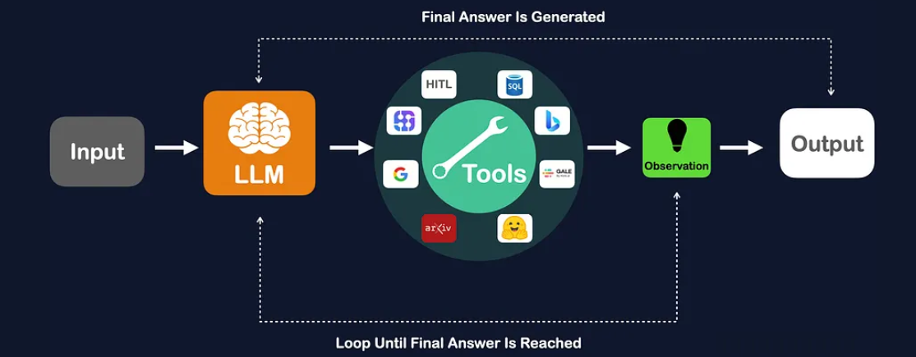
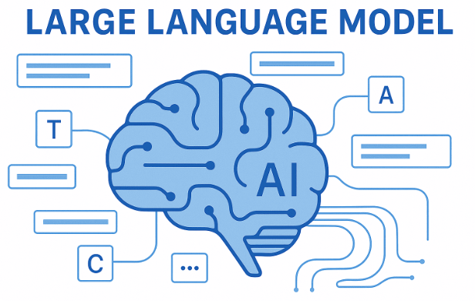
LLM = Large Language Model
LLM stands for Large Language Model, a type of artificial intelligence trained on vast amounts of text data to understand, process, and generate human-like text. These models use transformer architectures to learn language patterns and context, enabling them to perform tasks like text generation, translation, summarization, question-answering, and content creation.

Slide 3
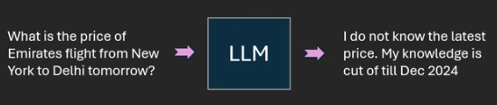
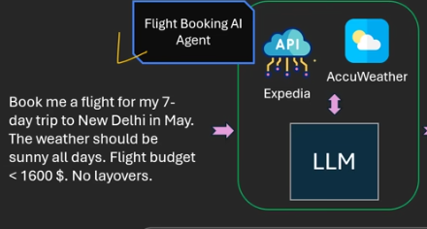
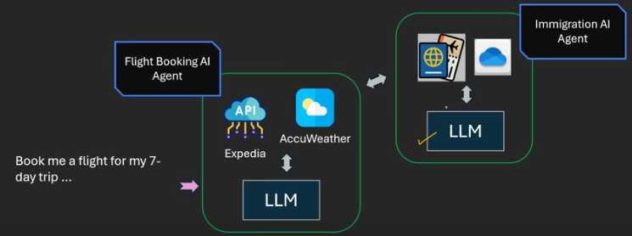
Ai System Type | Gen Ai (LLM Only) | Ai Agent | Agentic Ai
Task Capability | Answer based on pre Trained knowledge only. Like Text, images, audio and videos ChatGPT, Gemini | Task Input, Decide and Action/Completes a task using tools,Memroy,Data,api | Handle the multiple step with planning and co-ordination
Tool | No Extra Tool ☒ | Uses the Tools to complete the task | Uses multiple tools and call other AI agents.
Decision | No Decision Making ☒ | Make Decision complete the task | Plan , Decide and Autonomous Decision

Slide 4
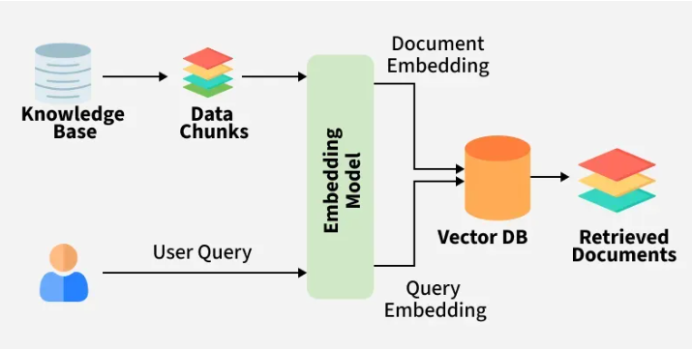
RAG = Retrieval-Augmented Generation
RAG is an AI framework that improves the output of large language models (LLMs) by giving them access to external or private data up-to-date knowledge bases before generating a response.
RAG Powerful Knowledge base retrieval.
RAG input text and get the output improved text output.

Slide 5
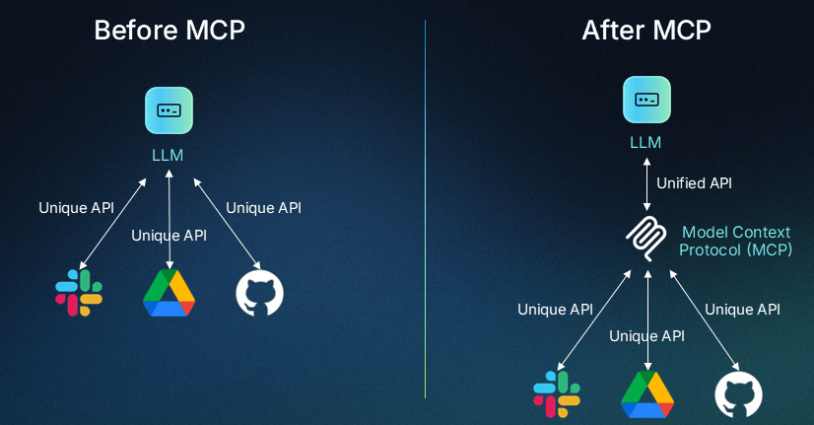
MCP - Model Context Protocol
Open-source framework that allows large language models (LLMs) to securely and standardized interact with external data sources and tools API, application,databases..etc.
MCP input text and get the output improved text and action output.
RAG and MCP combined integration tools more powerful.

Slide 6
Gen AI Tools
https://chatgpt.com/
https://claude.ai/
https://gemini.google.com/
https://chat.deepseek.com/
https://webenoid.com/

Slide 7



Blogger & App
https://gitlab.com/mohan4295work
https://github.com/mohan4295work
https://mohan4295.blogspot.com/

